Slide 1
System Architecture
Testing and validation plaforms
Master’s Degree in Smart Energy Systems

Slide 2
Contents
What is a System Architecture
Systems and Emergence
Architecture and Views
Analysis of System Architecture
Form and Function
Structural Decomposition and Functional Decomposition
View types

Slide 3
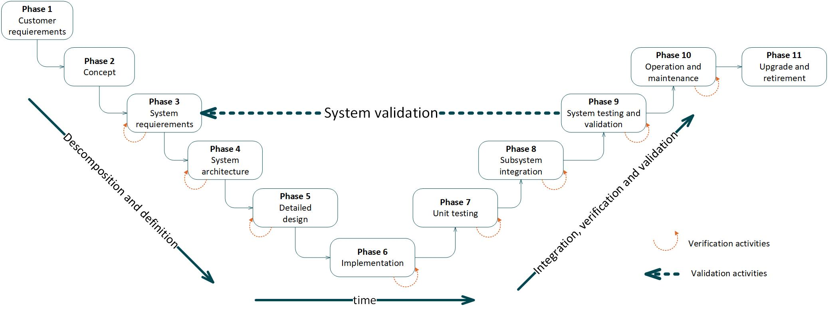
Contents
3. Architecture

Slide 4
What is a System Architecture
1

Slide 5
What is a System: Emergence
A system is a set of entities and their relationships,
whose functionality is greater than the sum of the individual entities. Crawley, E. et al., (2016)
System Architecture. Pearson.
A system is not the sum of the parts, but the product of the interaction of those parts.
Russell Ackoff.

Slide 6
What is a System Architecture
Architecture
It is the conceptual model that defines the structure, behavior, and more views of a system. Hannu Jaakkola and Bernhard Thalheim. (2011)
View
The purpose of views and viewpoints is to enable humans to comprehend very complex systems. Edward J. Barkmeyer et al. (2003)

Slide 7
Analysis of System Architecture
2

Slide 8
Structural and Functional Decomposition
2.1
Analysis of System Architecture

Slide 9
Form and Function
A system’s structure can be decomposed in two forms:
Structural decomposition (form).
Functional decomposition (function).

Slide 10
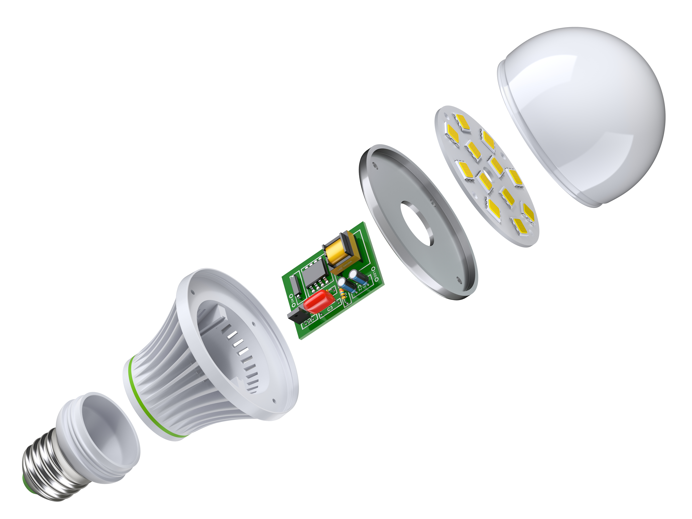
Structural Decomposition
Example: light bulb
leds
cover
electronics
case
base
socket
Vista explotada de la bombilla led
DepositPhotos, 2016. ID:121401858

Slide 11
Structural Decomposition
Example: light bulb
Vista explotada de la bombilla led
DepositPhotos, 2016. ID:121401858

Slide 12
Structural Decomposition
Example: light bulb
Each subsystem is decomposed and organized in hierarchies
Vista explotada de la bombilla led
DepositPhotos, 2016. ID:121401858

Slide 13
Decomposition hierarchy
Each subsystem is decomposed and organized in hierarchies

Slide 14
View Types
2.2
Analysis of System Architecture

Slide 15
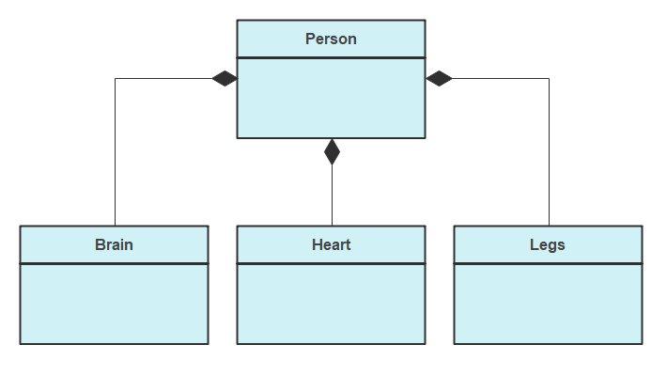
View Types
Composition Diagram

Slide 16
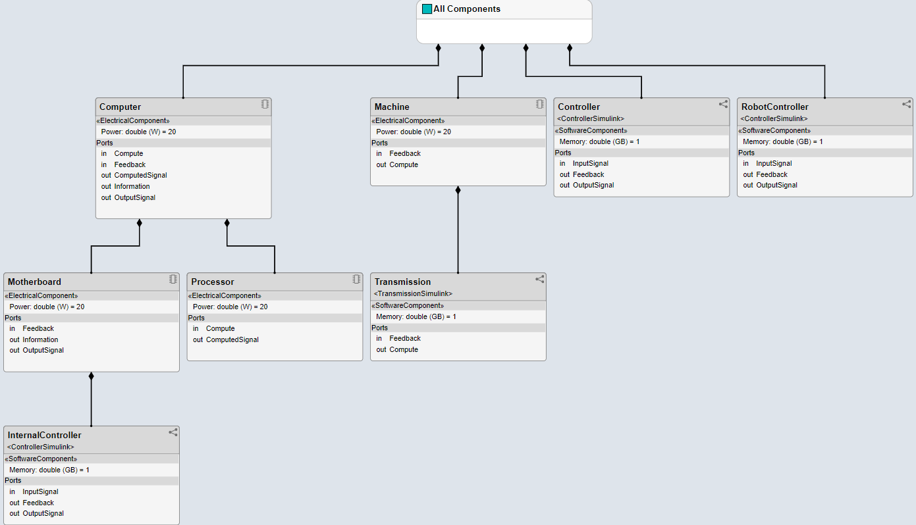
View Types
Composition Diagram (in System Composer)

Slide 17
View Types
Composition Diagram: Composition vs. Aggregation
Car
Car
Engine
Passengers
Composition: every car has an engine
Aggregation: cars may have passengers, they come and go

Slide 18
View Types
Composition Diagram: Composition vs. Aggregation
Car
Pasajero
Aggregation: delete the car and the passenger can travel somewhere else
Engine
Composition: delete the car and the engine is useless

Slide 19

View Types
Use-case Diagram
Transfer money
<<include>>
client
Check status
Withdraw money
Bank officer
ATM

Slide 20
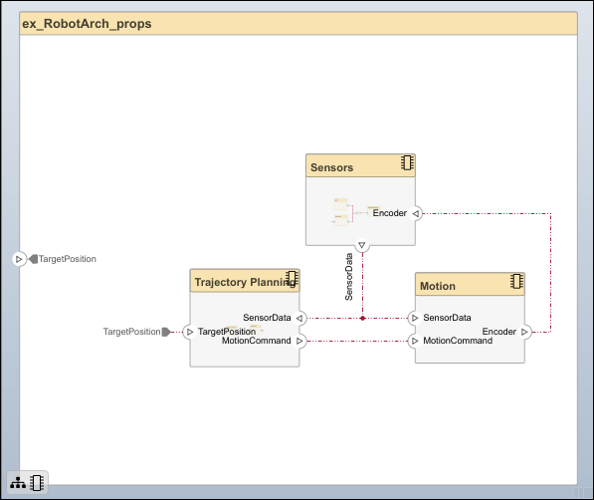
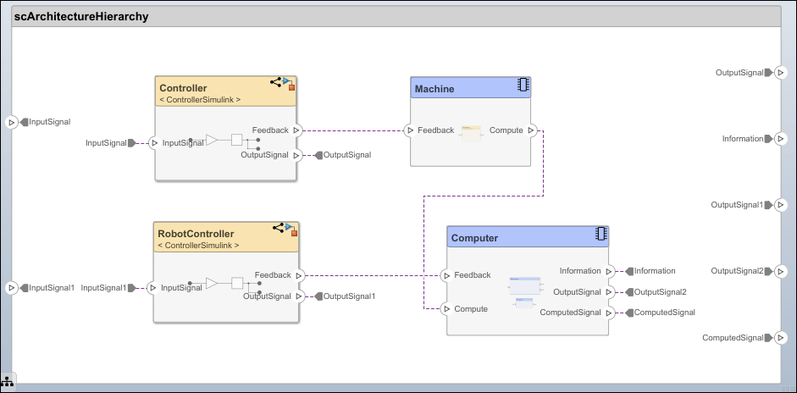
View Types
Interfaces

Slide 21
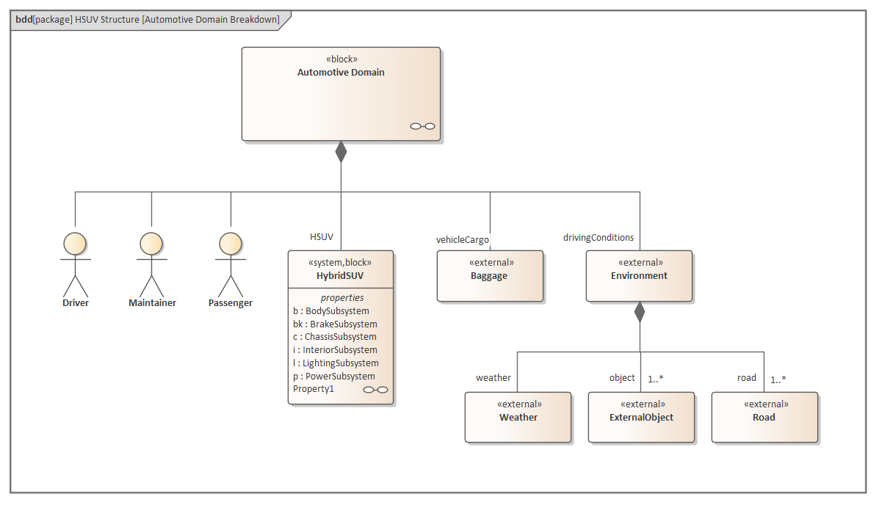
View Types : Standard modelling languages
Architecture modelling can be performed following different languages.
SysML is a general-purpose graphical modelling language for specifying, analyzing, designing, and verifying complex systems.
https://sparxsystems.com/enterprise_architect_user_guide/14.0/model_domains/sysml.html

Slide 22
References
3

Slide 23
References
System Architecture. Strategy and Product Development for Complex Systems E. Crawley, B.Cameron, D. Selva (2016)
Systems Architecting. A Business Perspective Gerrit Muller (2012)
The secret of APOLO. Systems Management in American and European Space Programs Stephen B. Johnshon (2002)
Architecting Software Intensive Systems. A Practitioner’s Guide Anthony J. Lattanze (2009)

Slide 24
Eskerrik asko
Muchas gracias
Thank you
Paul Aretxederreta
paretxederreta@cafpower.com
www.linkedin.com/in/paul-aretxederreta
Parque Tecnológico de San Sebastián
Paseo Mikeletegi, 58 - 2º
20009 San Sebastián • Spain
www.cafpower.com

